Slide 1
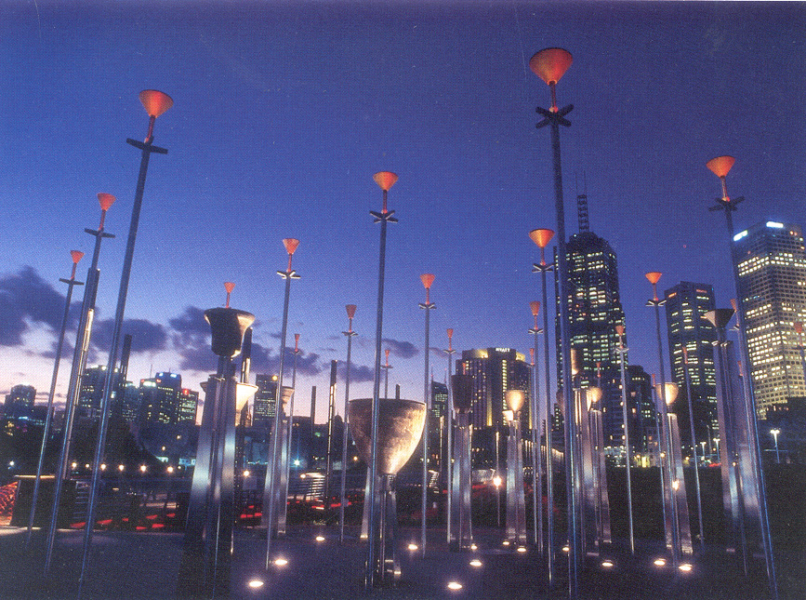
Specialist bell design processes
Audio Engineering Society
Australian Bell Projects: Dr Anton Hasell
Adjunct Professor, Spatial Information Architecture Laboratory, RMIT University
Federation Bells Carillon 1998-2002

Slide 2
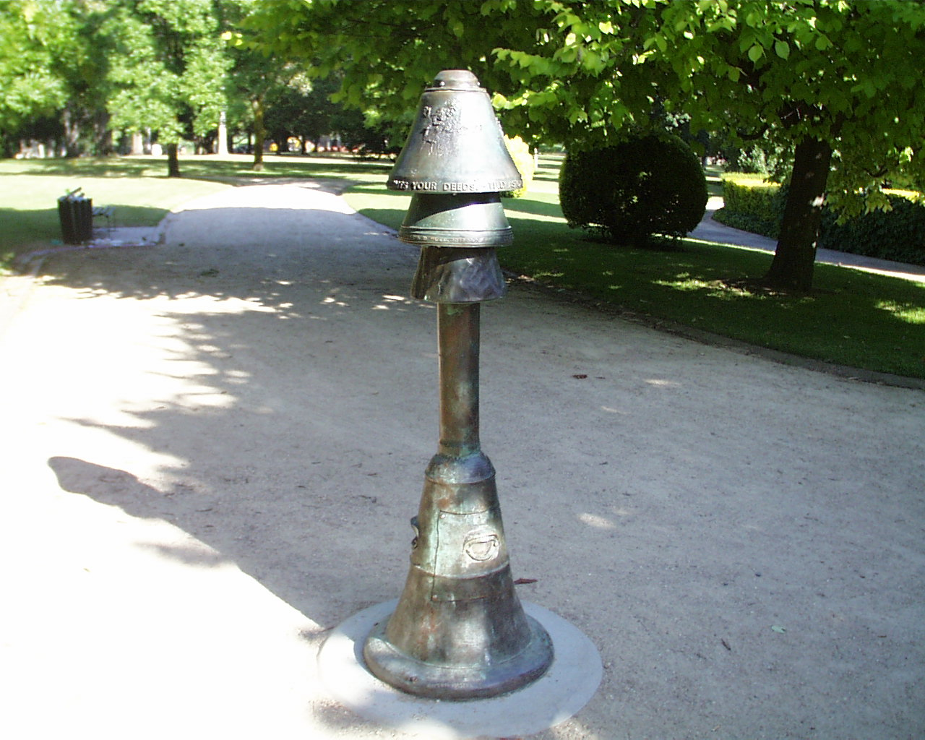
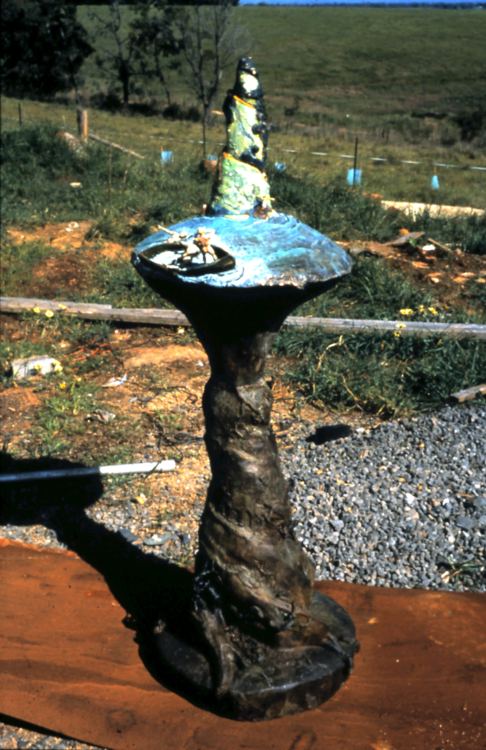
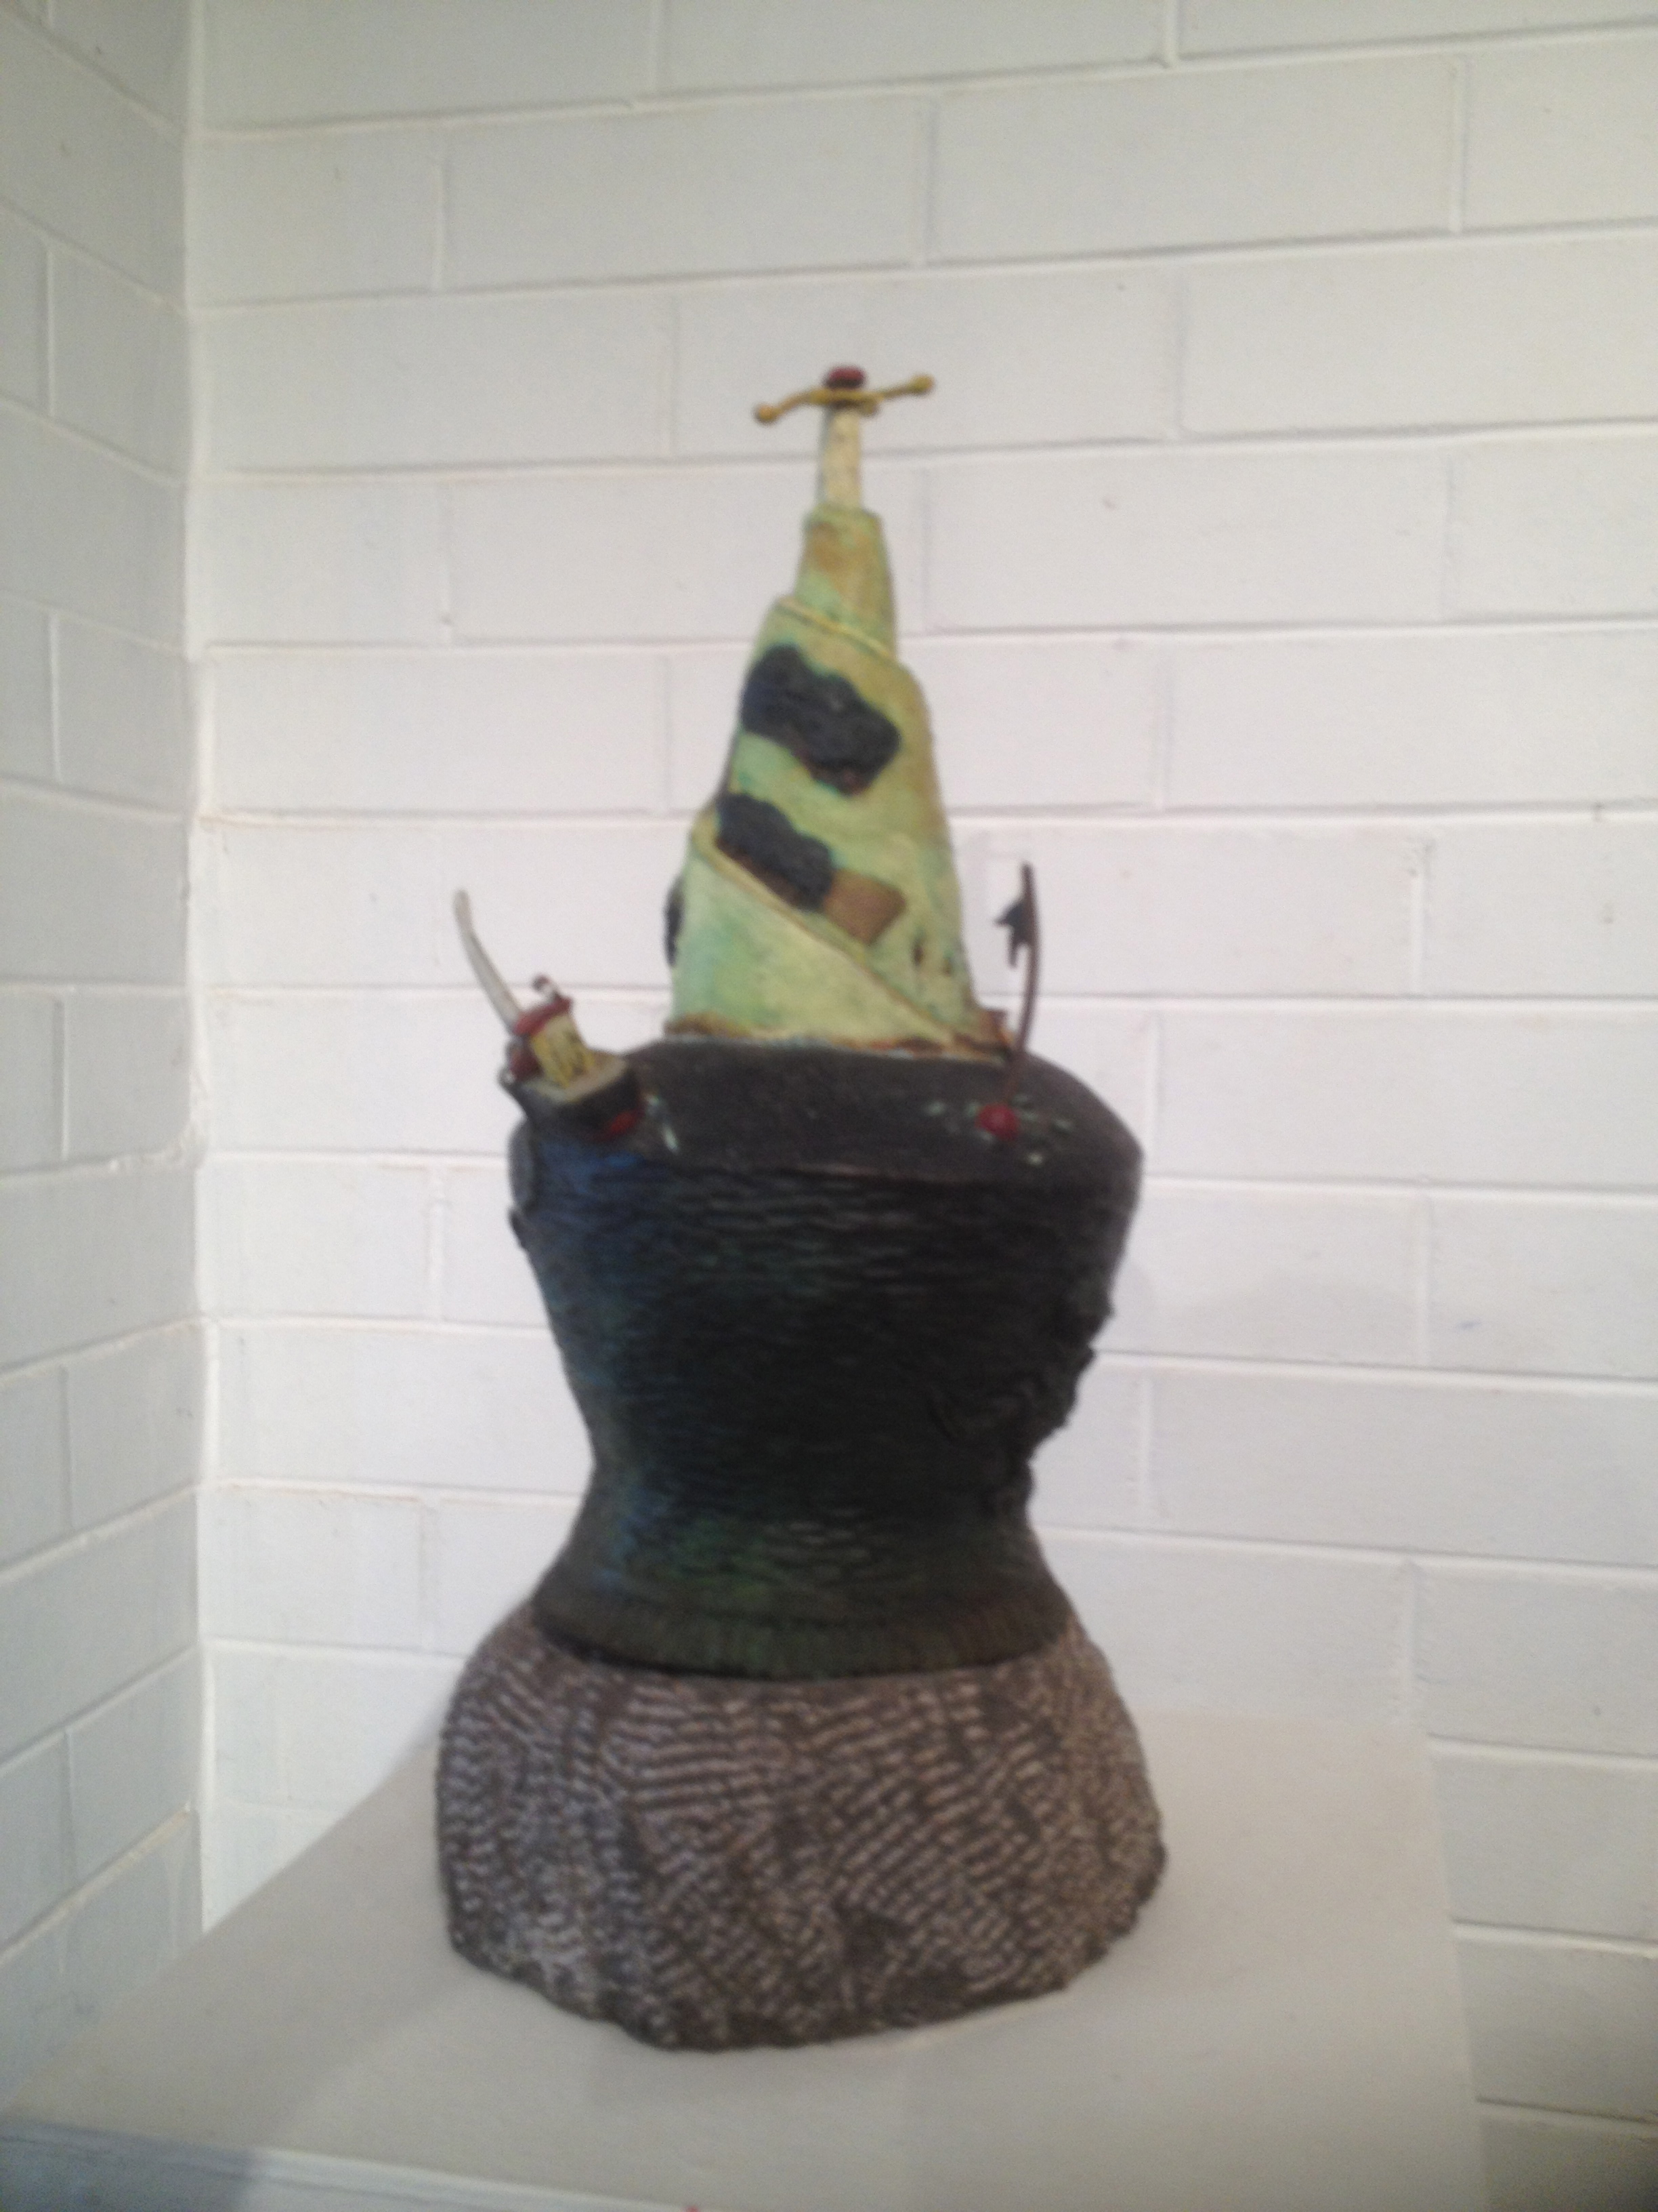
My journey into the science of bell acoustics began in the 1990’s with a transition from sculpture as form, to forms that generate sound.
The theme of my ongoing research is to develop new forms, when vibrated, radiating new musical sound. As these sounds are first heard in Mia Mia, I surmise they are frequency arrays resonant with Mia Mia’s ambient soundscape. I think of the resulting bells as bronze vessels whose refined shapes store specific frequency arrays slabs of the Mia Mia soundscape.
‘Tilly Aston Bell’ Kings Domain Gardens, Melbourne 1996
‘The Island’ bronze sculpture 1992 and ‘Amageddon Bell’ sculpture 1993

Slide 3
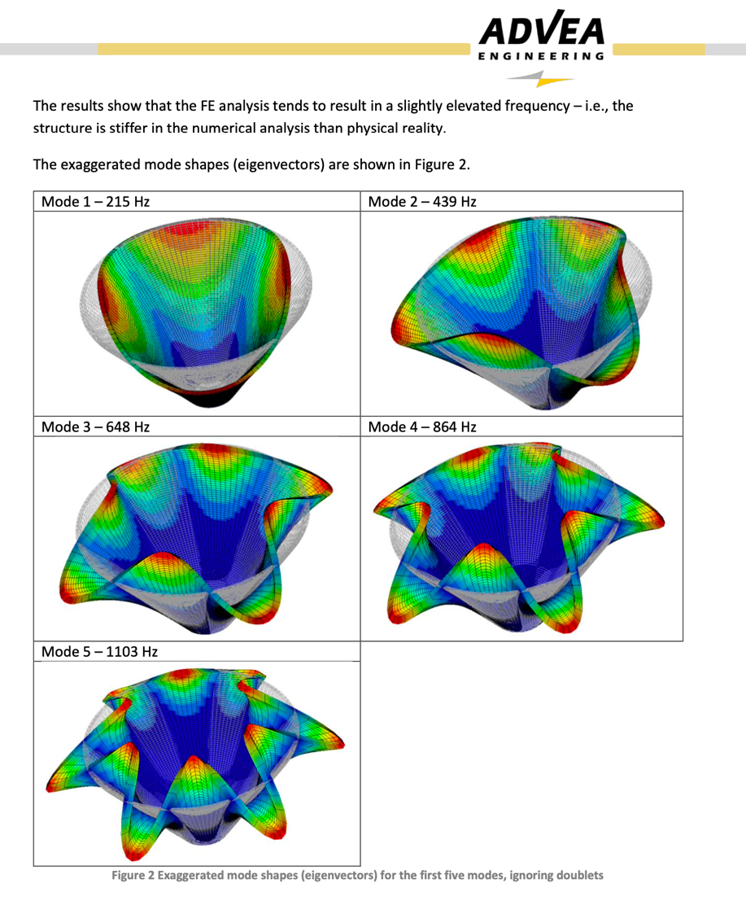
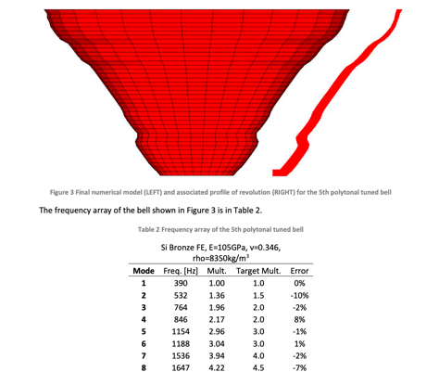
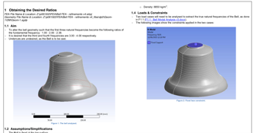
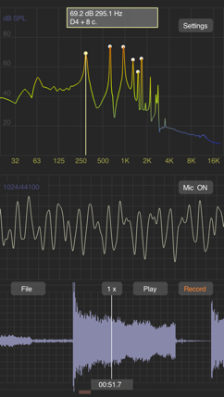
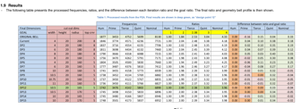
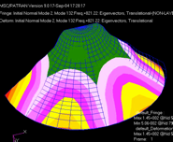
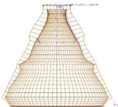
The acoustic design takes place in Finite Element Analysis software

Slide 4
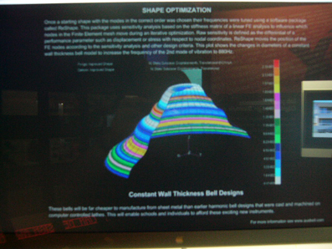
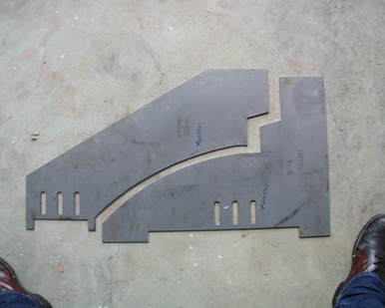
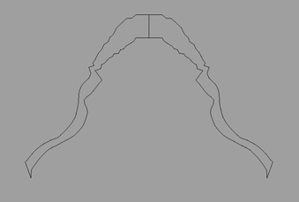
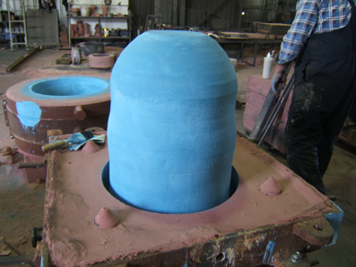
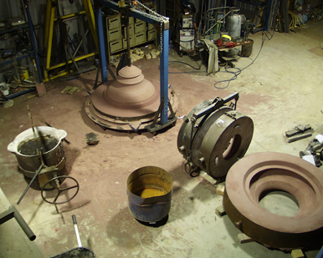
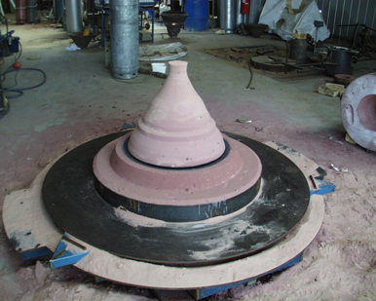
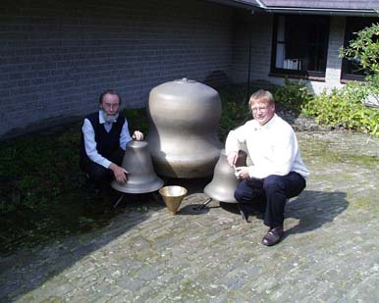
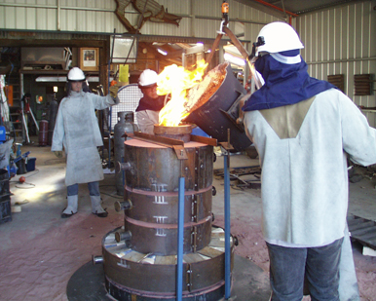
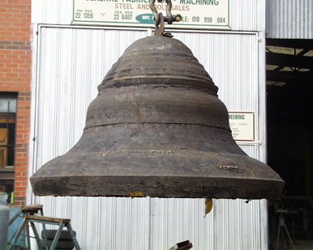
CASTING FEDERATION BELLS 1998-2001
The Federation Bells Projects, 1998-2002 was a collaboration between Anton Hasell and Neil McLachlan. We employed Behzad Keramti Nigjeh to use Professor Josef Tomas’s Finite Element Analysis optimizing software ‘ReSHAPE’ on bell design, and applied contemporary casting processes to the design and casting of contemporary bells. We completed three projects; the ‘2001 harmonic handbell’ project, a 2-octave set of ‘harmonic bells for the MSO’ and the Federation Bells Carillon Installation at Birrarung Marr Park.
These projects were commissioned by Sir Jonathan Mills AO, Artistic Director ‘Centenary of Federation Festival’ 2001.

Slide 5
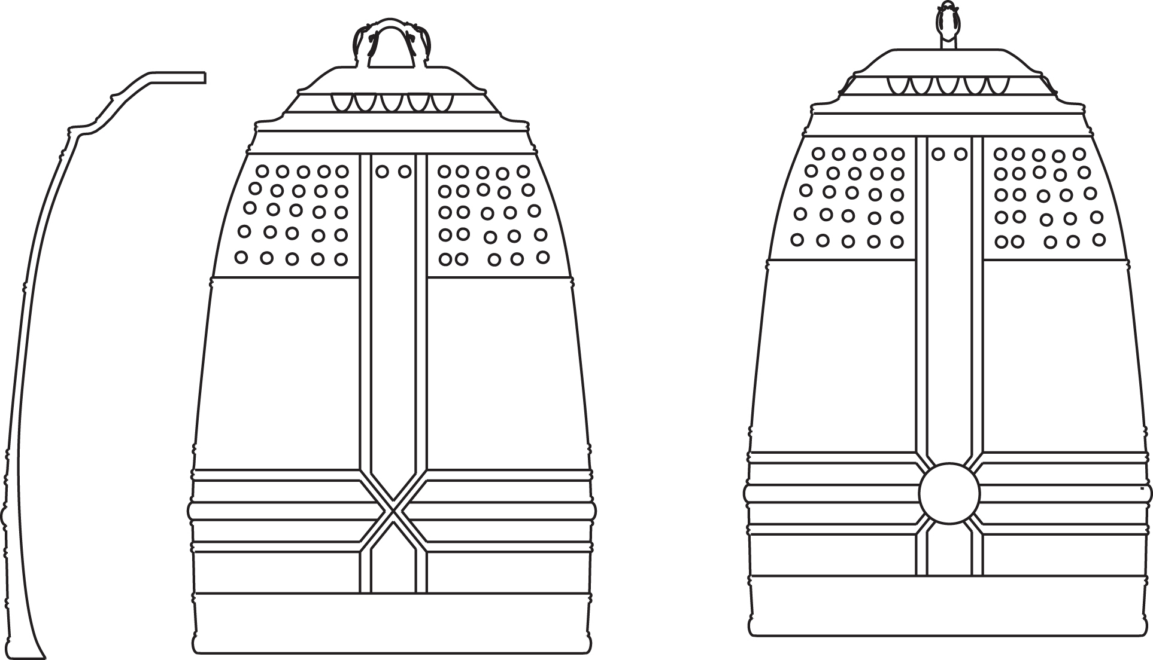
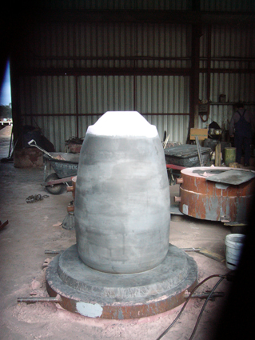
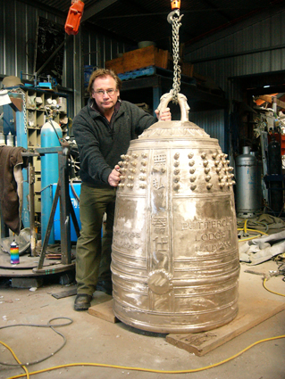
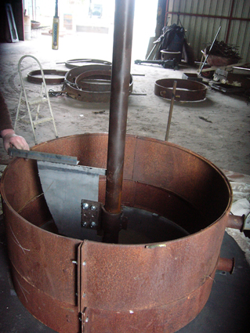
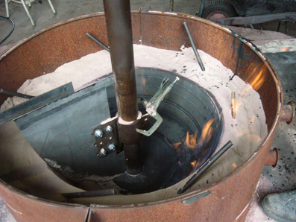
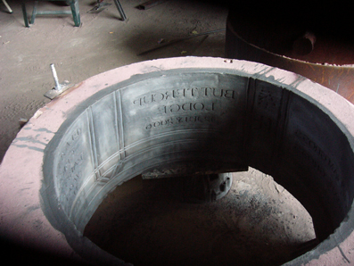
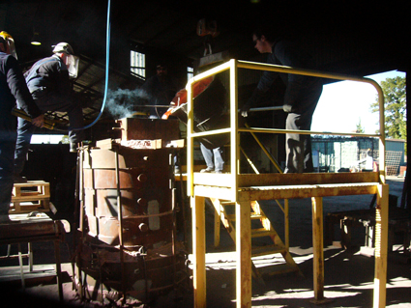
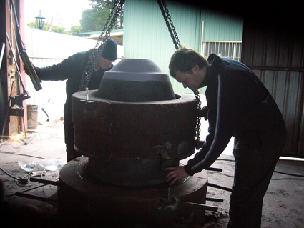
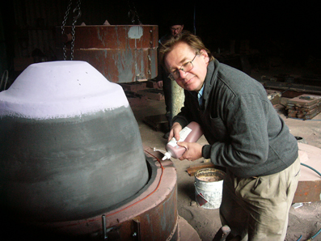
Casting of a Japanese temple bell in Castlemaine 2006

Slide 6
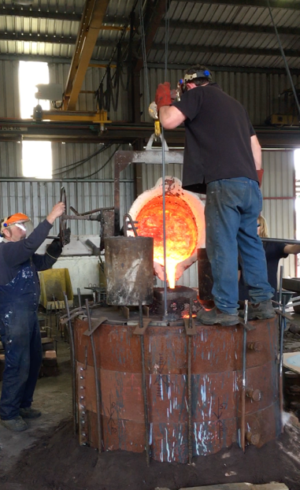
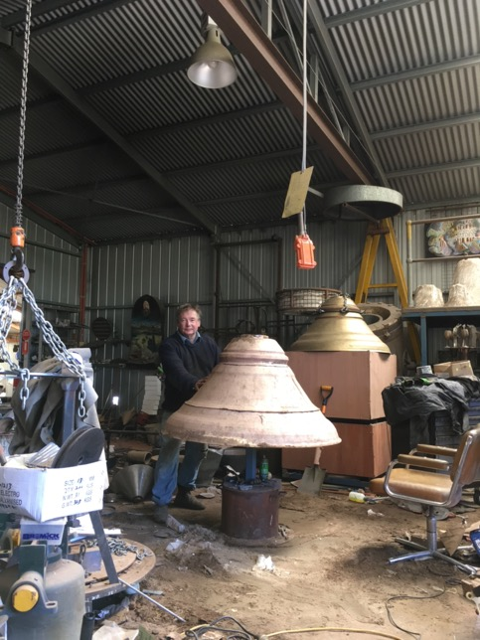
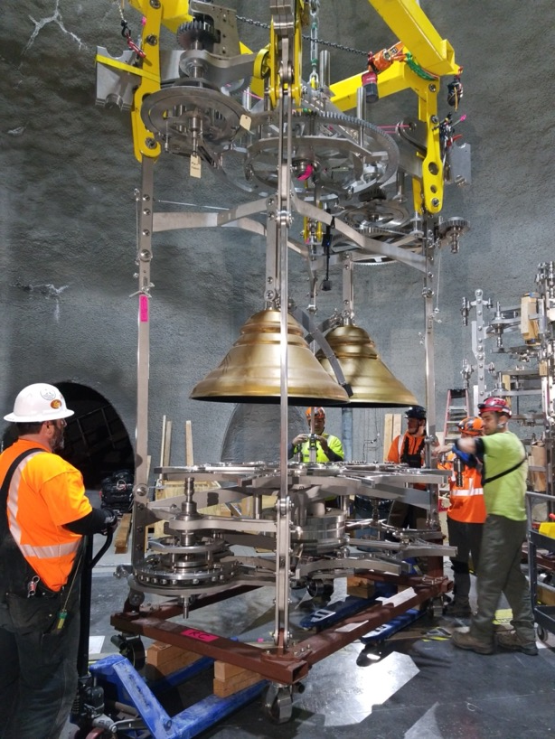
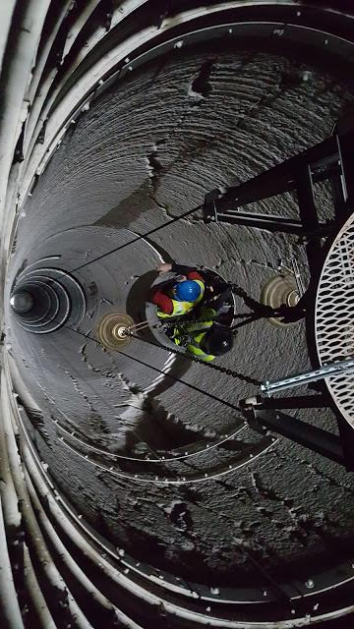
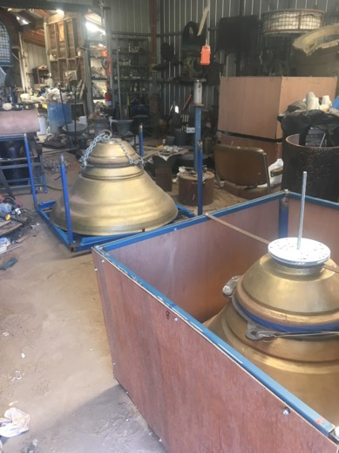
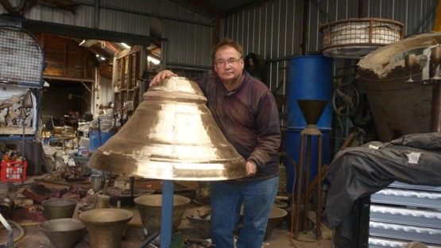
Making the LongNow 10,000 Year Clock bells 2014 – 2016
Working with ADVEA’s Ryan Adams using ReSHAPE software to invent ‘difference tone’ bell.
10 bells to be installed within the Clock mechanism inside a mountain in Texas, USA
(www.longnow.org/people/clock)
https://youtu.be/pKuJBGb_pN4

Slide 7
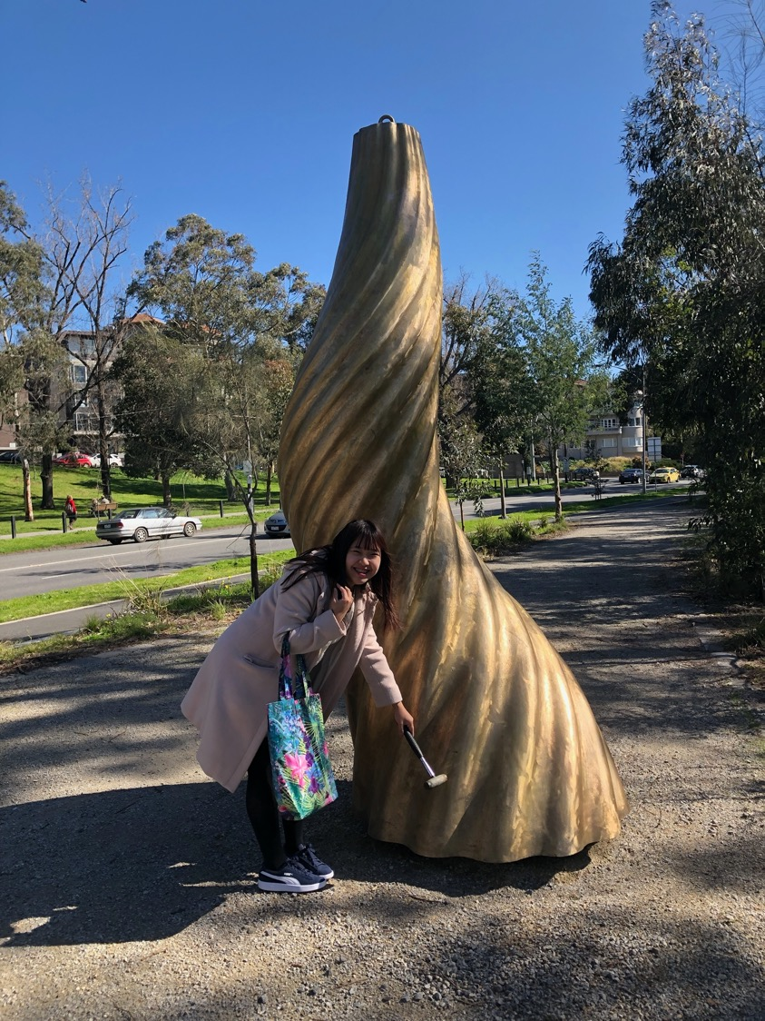
Research directions Australian Bell is exploring:
Musical possibility of ancient Asian bell design.
Elliptical ‘nao’ bells from pre-Han dynasty China were the first bronze musical sets of bells. Bringing FEA and modern casting technology to see what musicality can be achieved in this bell design through software iteration.
New shapes (and sounds) for ‘twisted’ sound vessels.
Using 3D computer modelling software to model complex twisting forms as sculpture and as vibrational vessels for new kinds of music experience.
3D printing bells in metal
Applying the technology of 3D printing in metal to bell design. Exploring the acoustic range of such printed objects. Printing allows the creation complex forms beyond the capability of cast forms.
Mechanical clocks and bells as sculpture
Exploring new sculptural forms for clocks and bells.
3 m tall ‘Twist Bell’ on the bank of the Yarra River, Melbourne. Australian Bell 02019

Slide 8
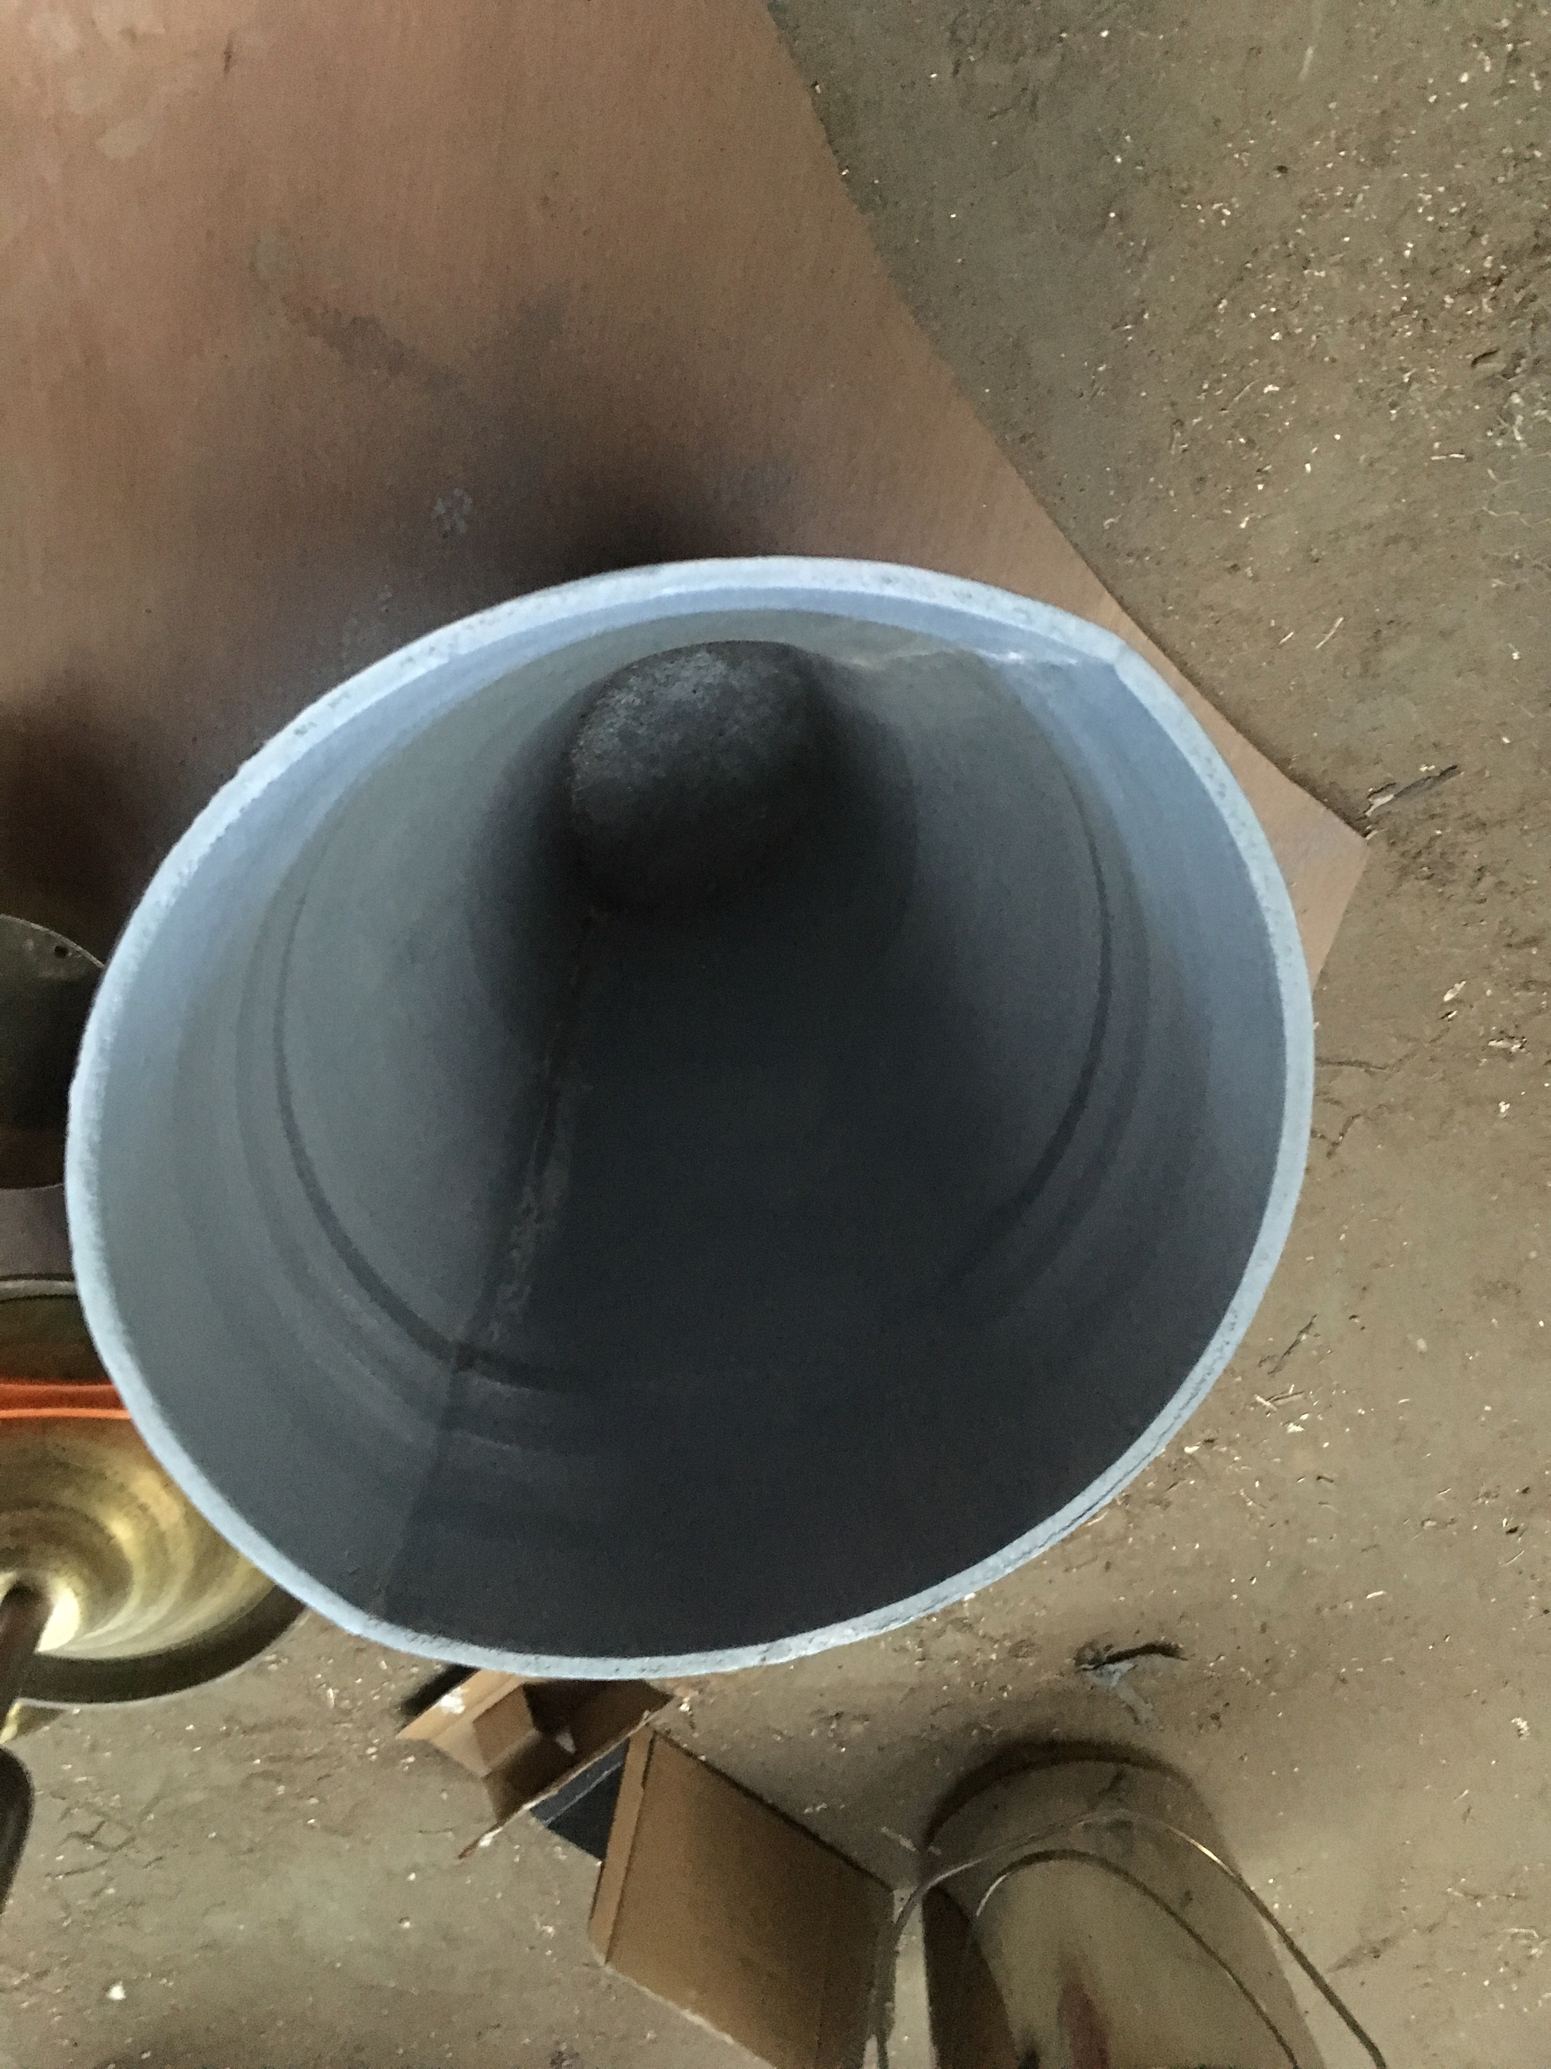
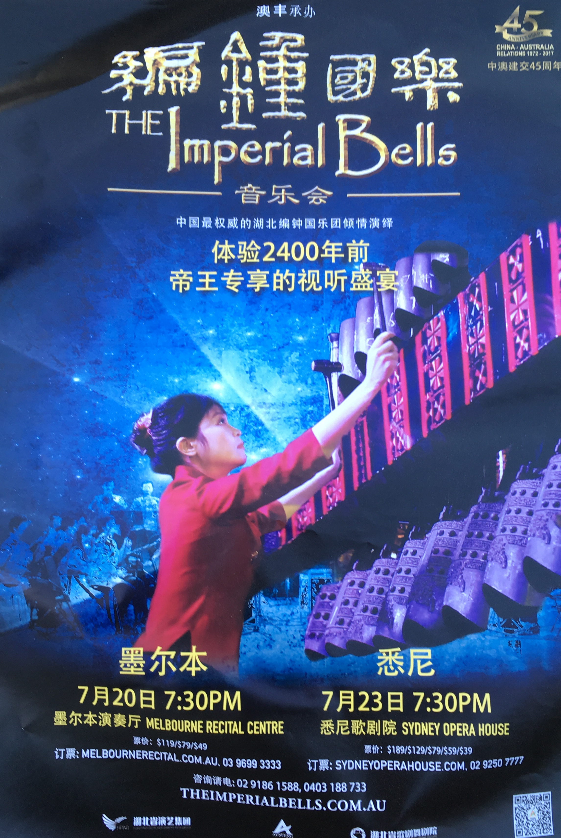
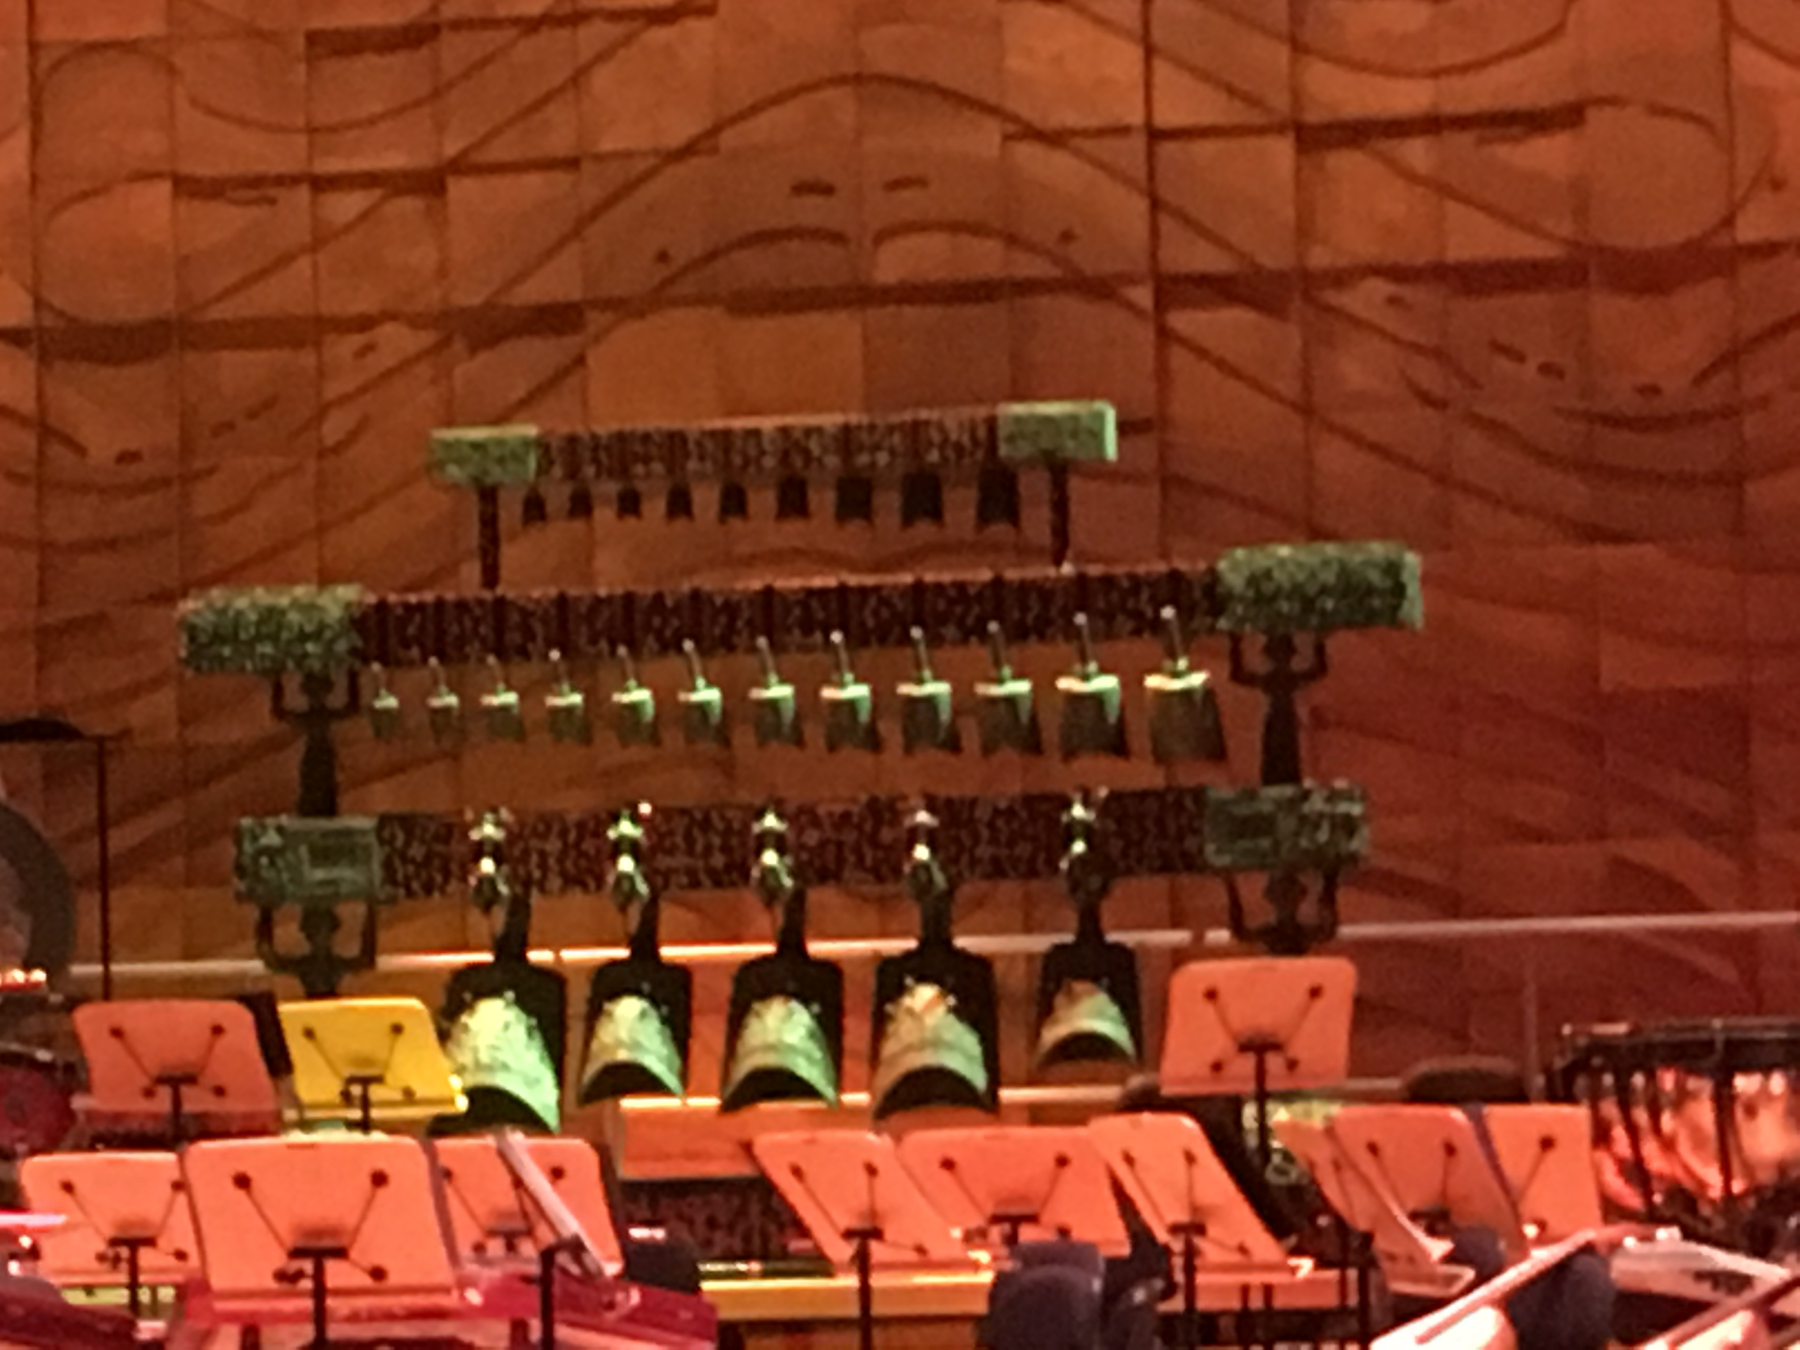
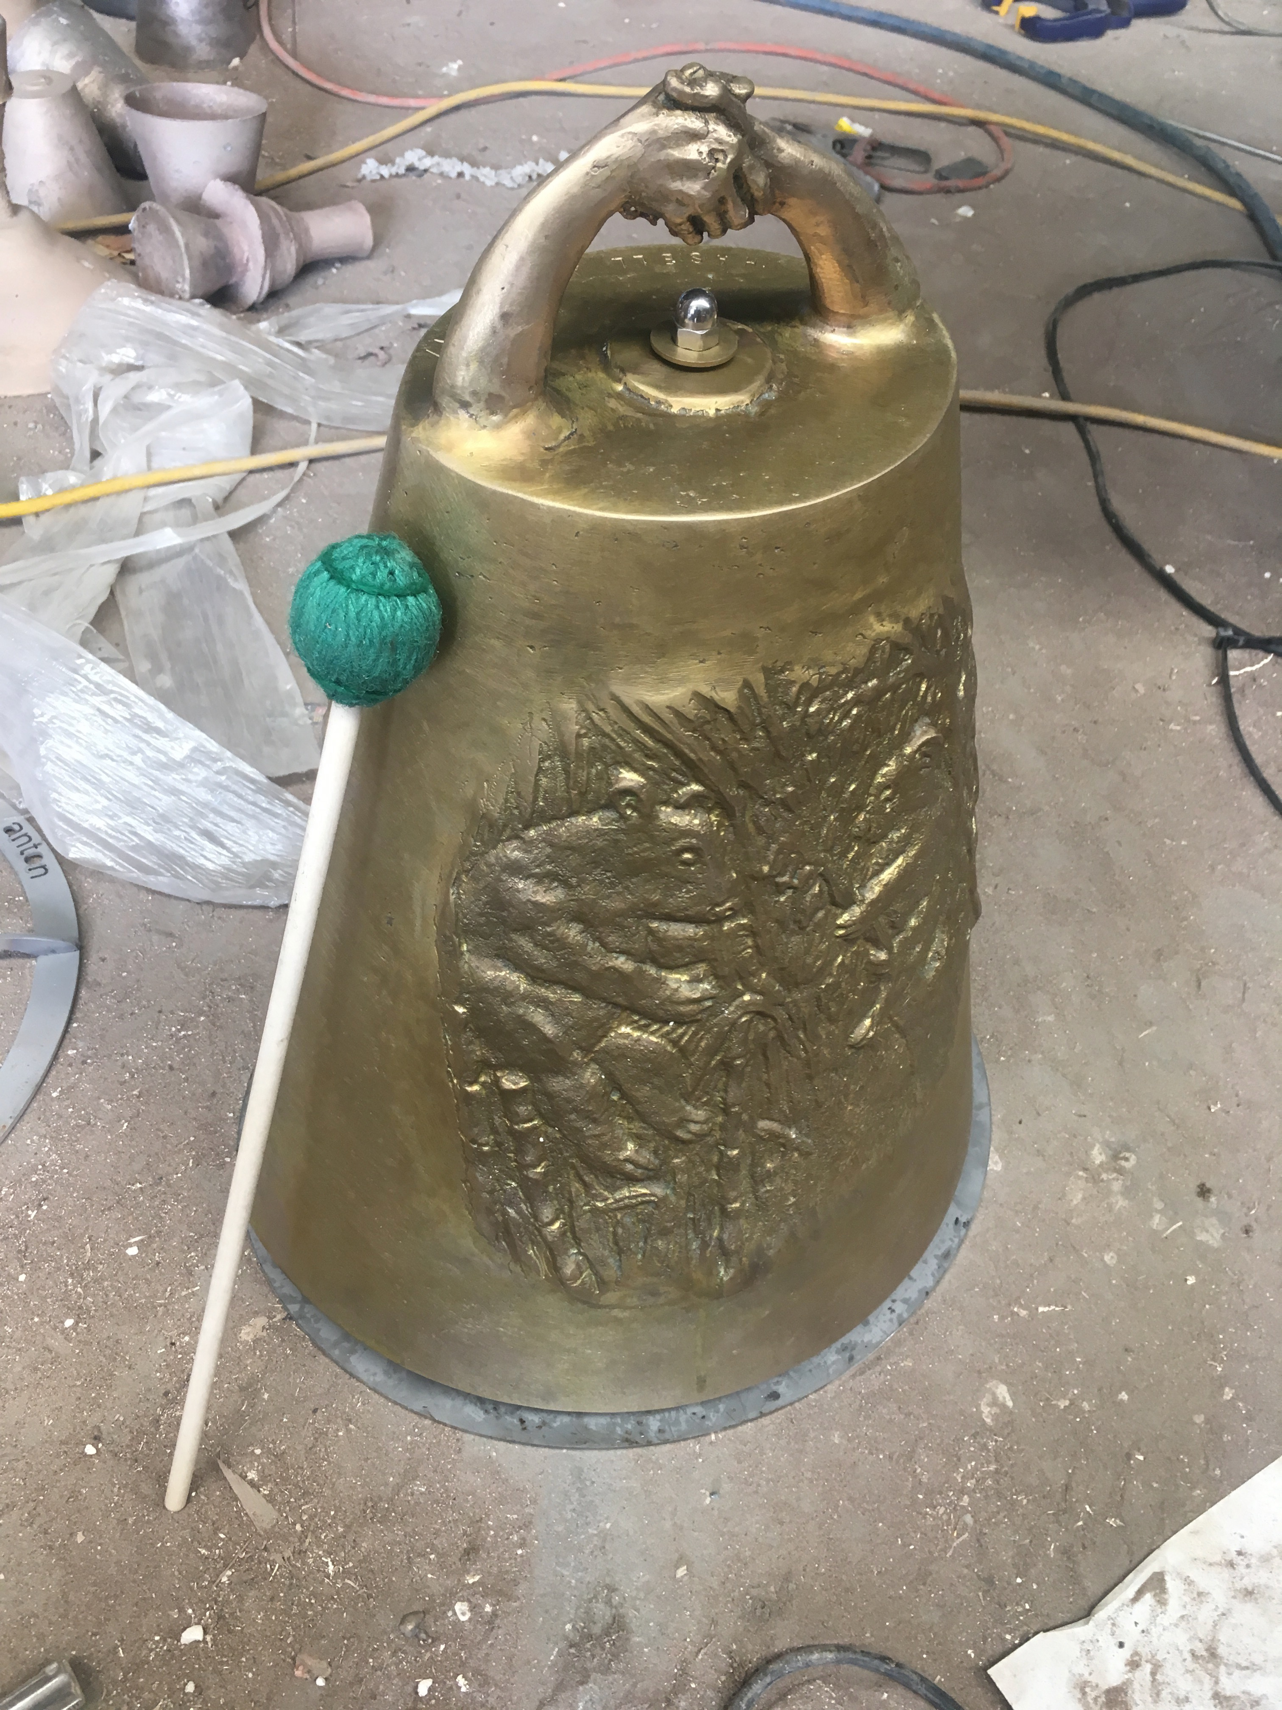
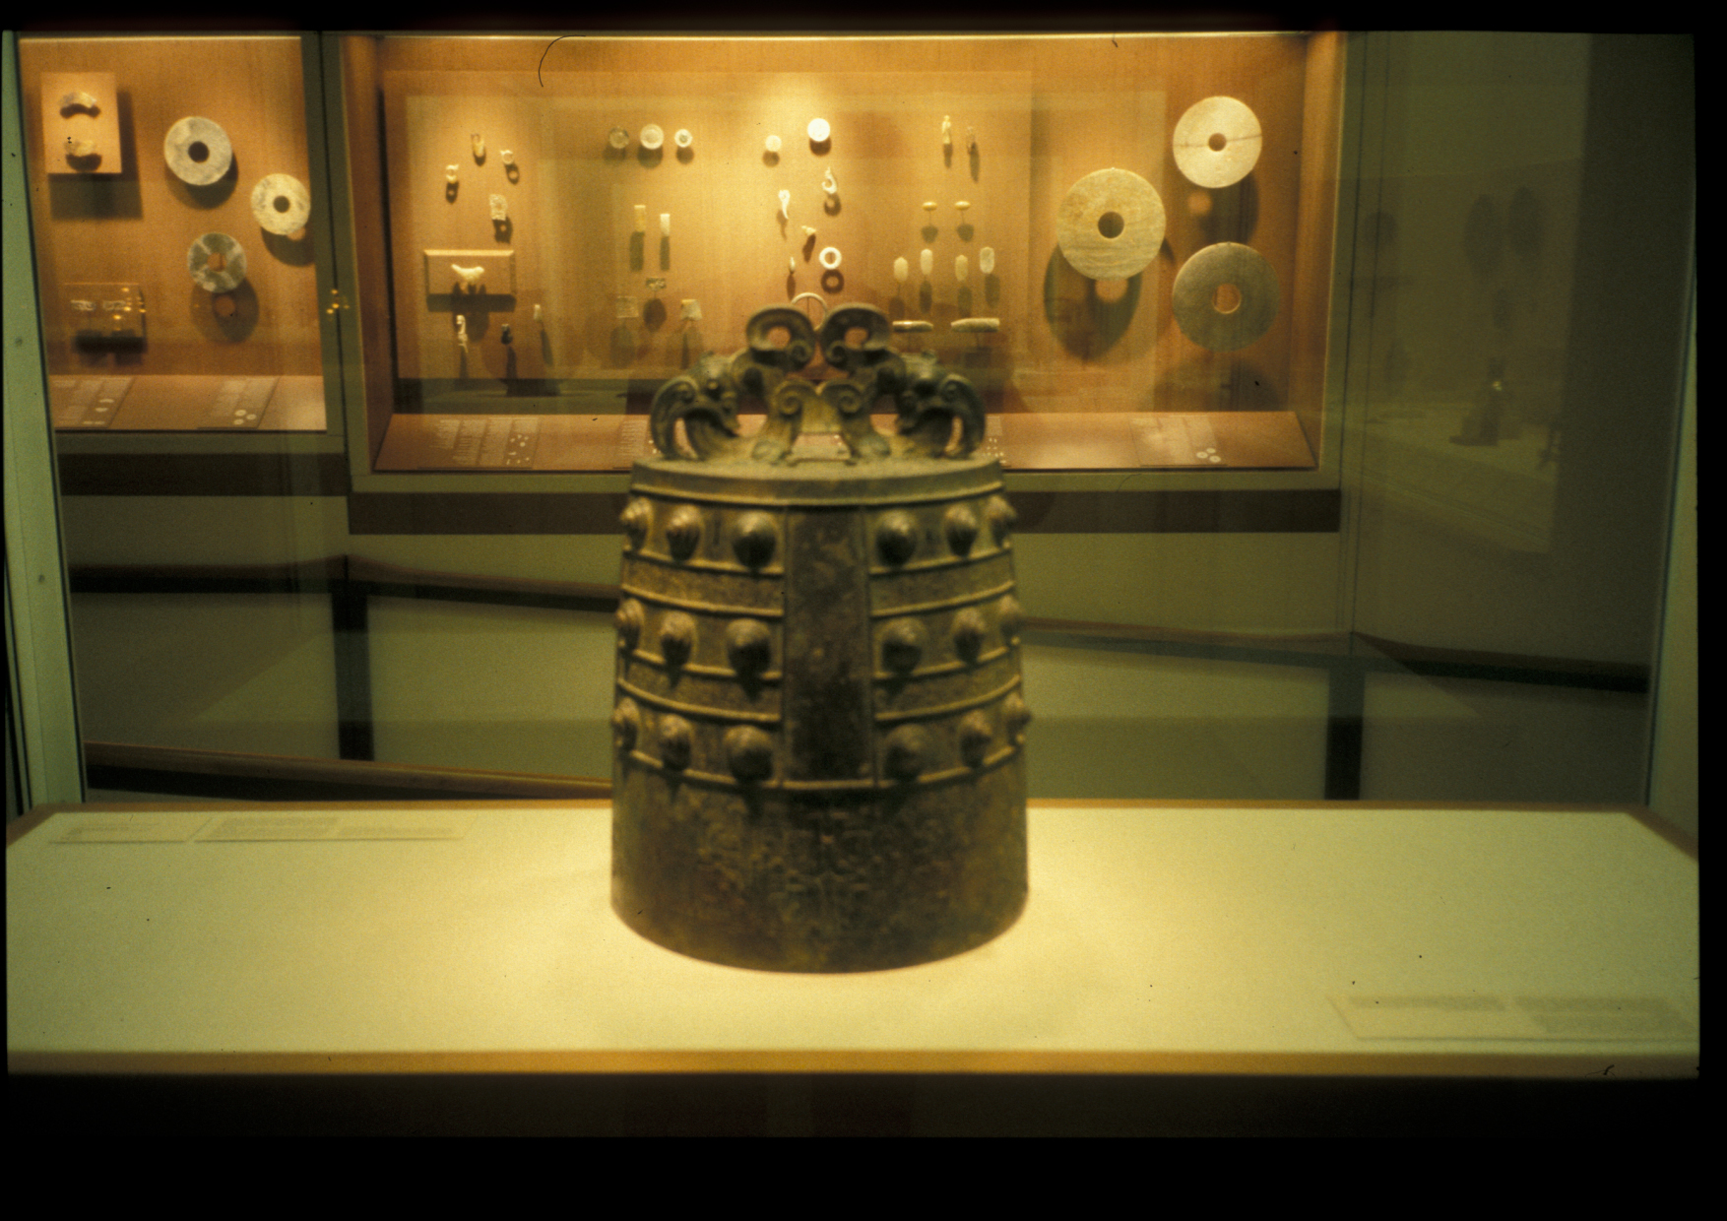
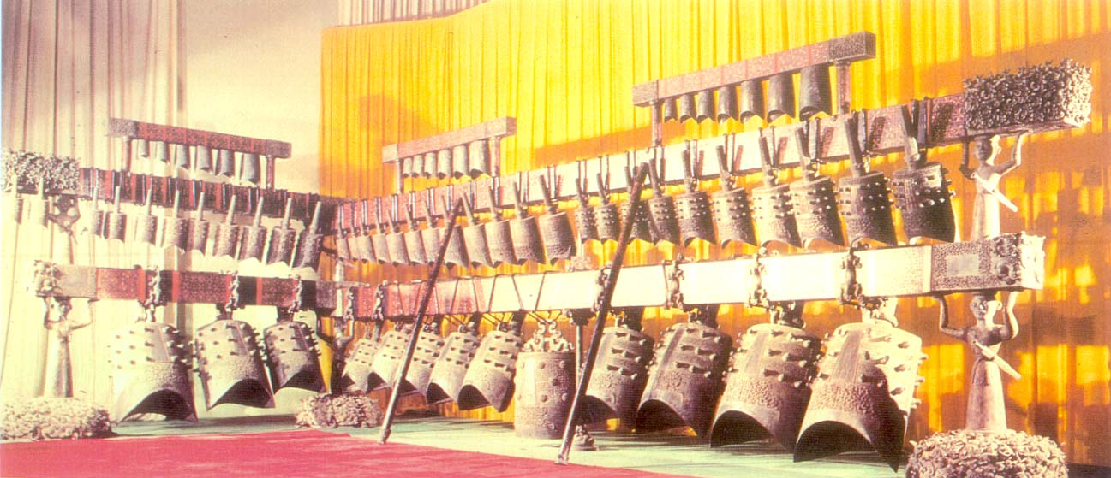
Researching ancient Chinese bell design
Nao bell pattern for Chengdu Museum 2017
Chime Conservatory Darwin 2008
Marquis Yi 63 nao bell set replica
Chengdu Museum bell
Nao bell British Museum

Slide 9
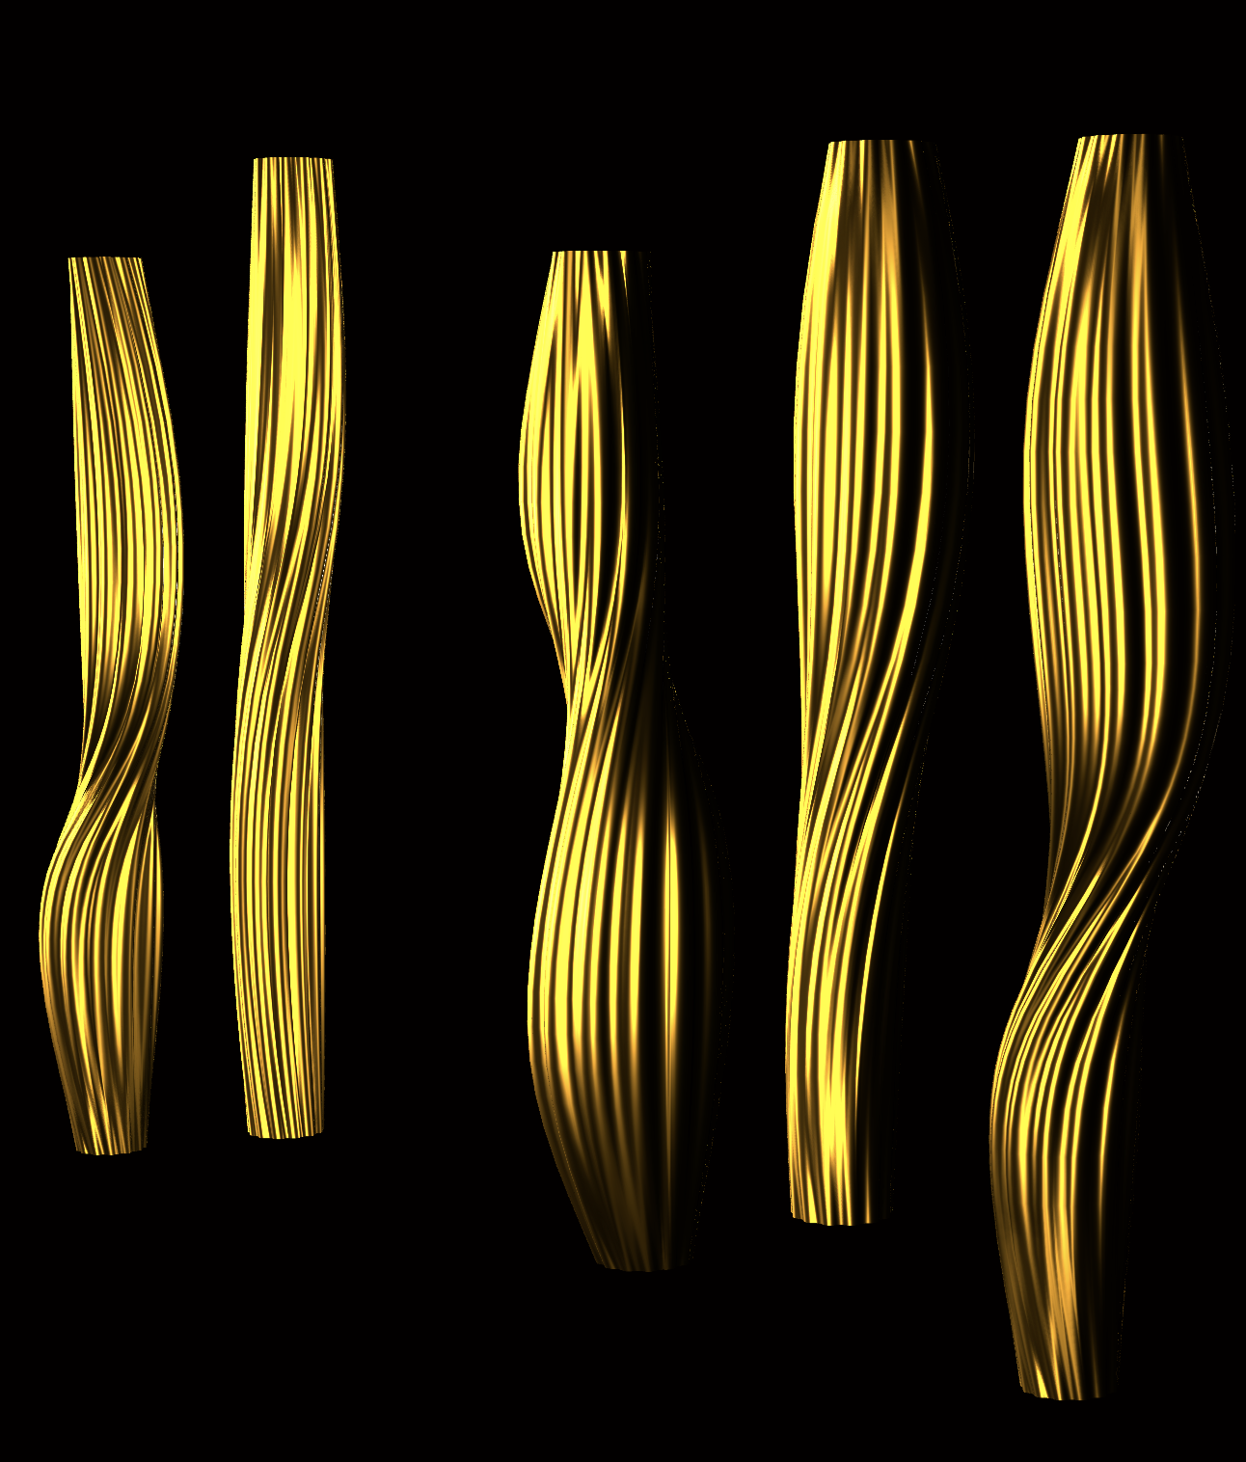
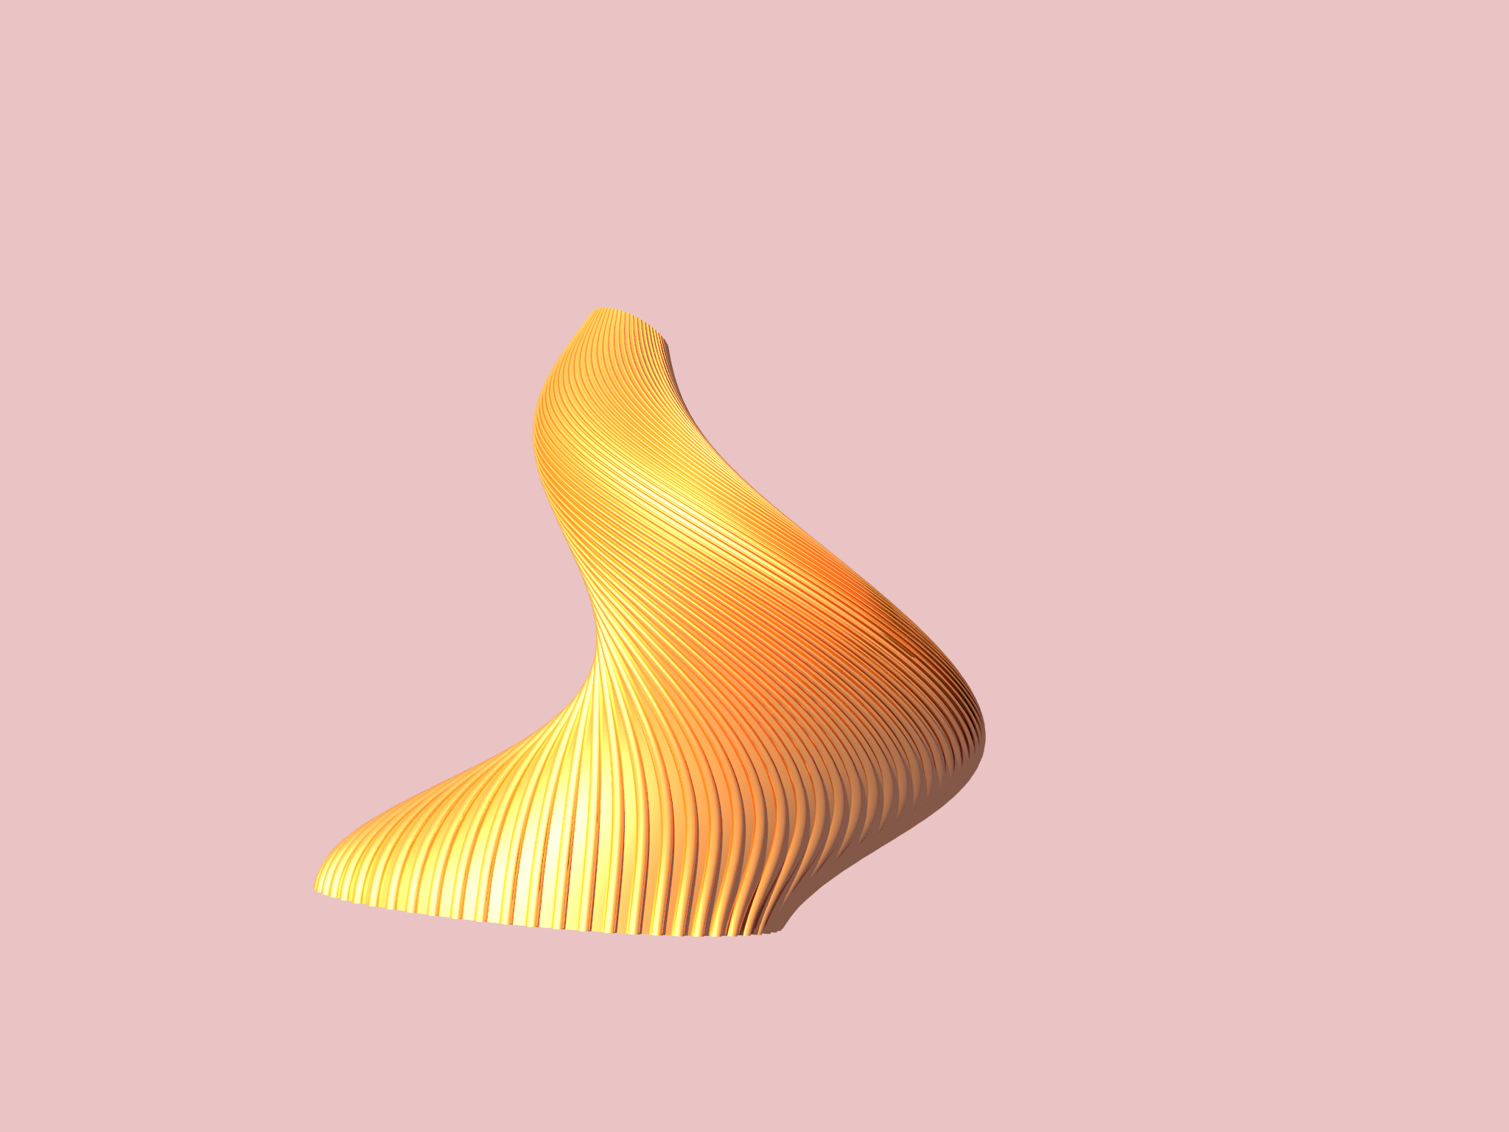
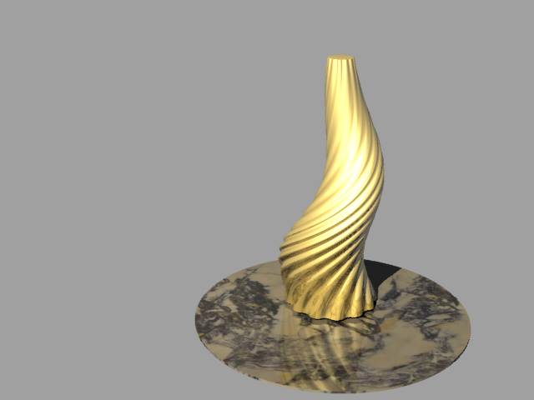
Twisted bronze vessel sculptures

Slide 10
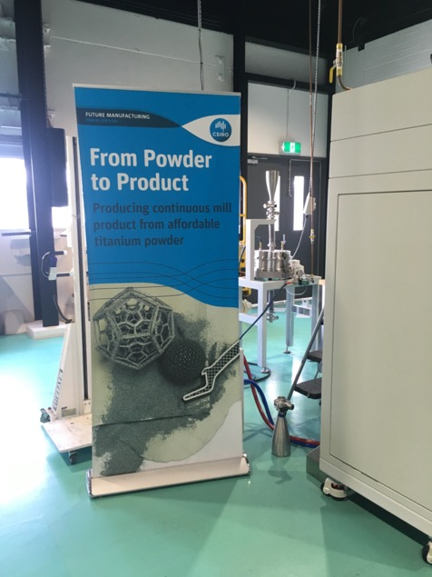
CSIRO Lab 22 Titanium bell I-beam 3D printing process. Bed is powdered titanium which the I-Beam fuses into the printed form
Working with Dr Daniel East, we 3D printed titanium ‘difference-tone’ bells and had EXONE in the USA 3D print in stainless steel and tin bronze 2 ‘difference-tone’ bells to understand the acoustic properties of 3D printed bells. A co-authored research paper was published in the August 2021 edition of the Leonardo journal.

Slide 11
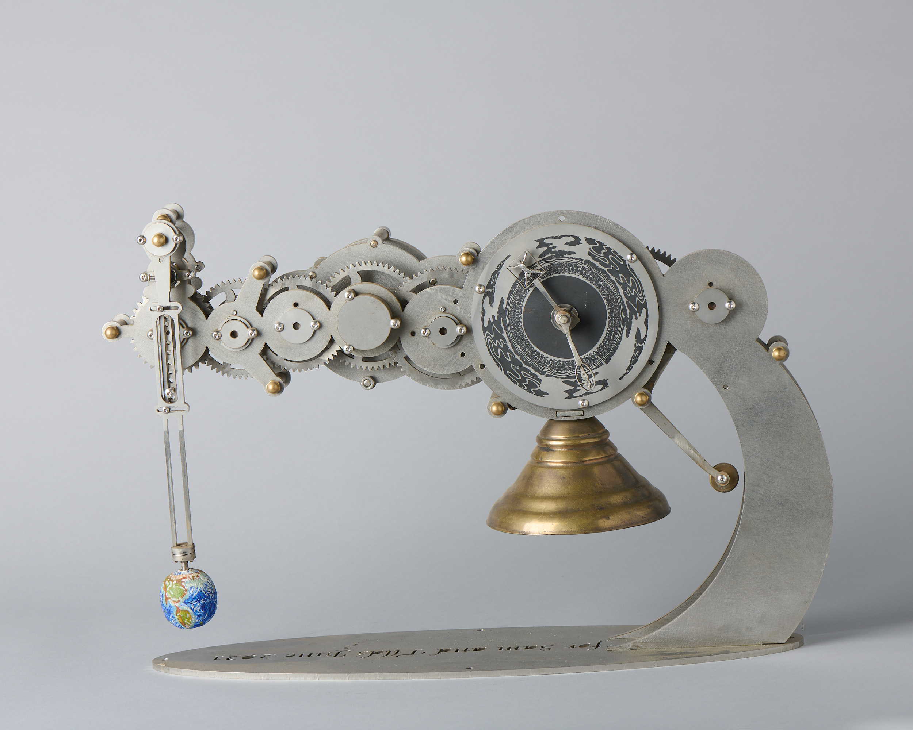
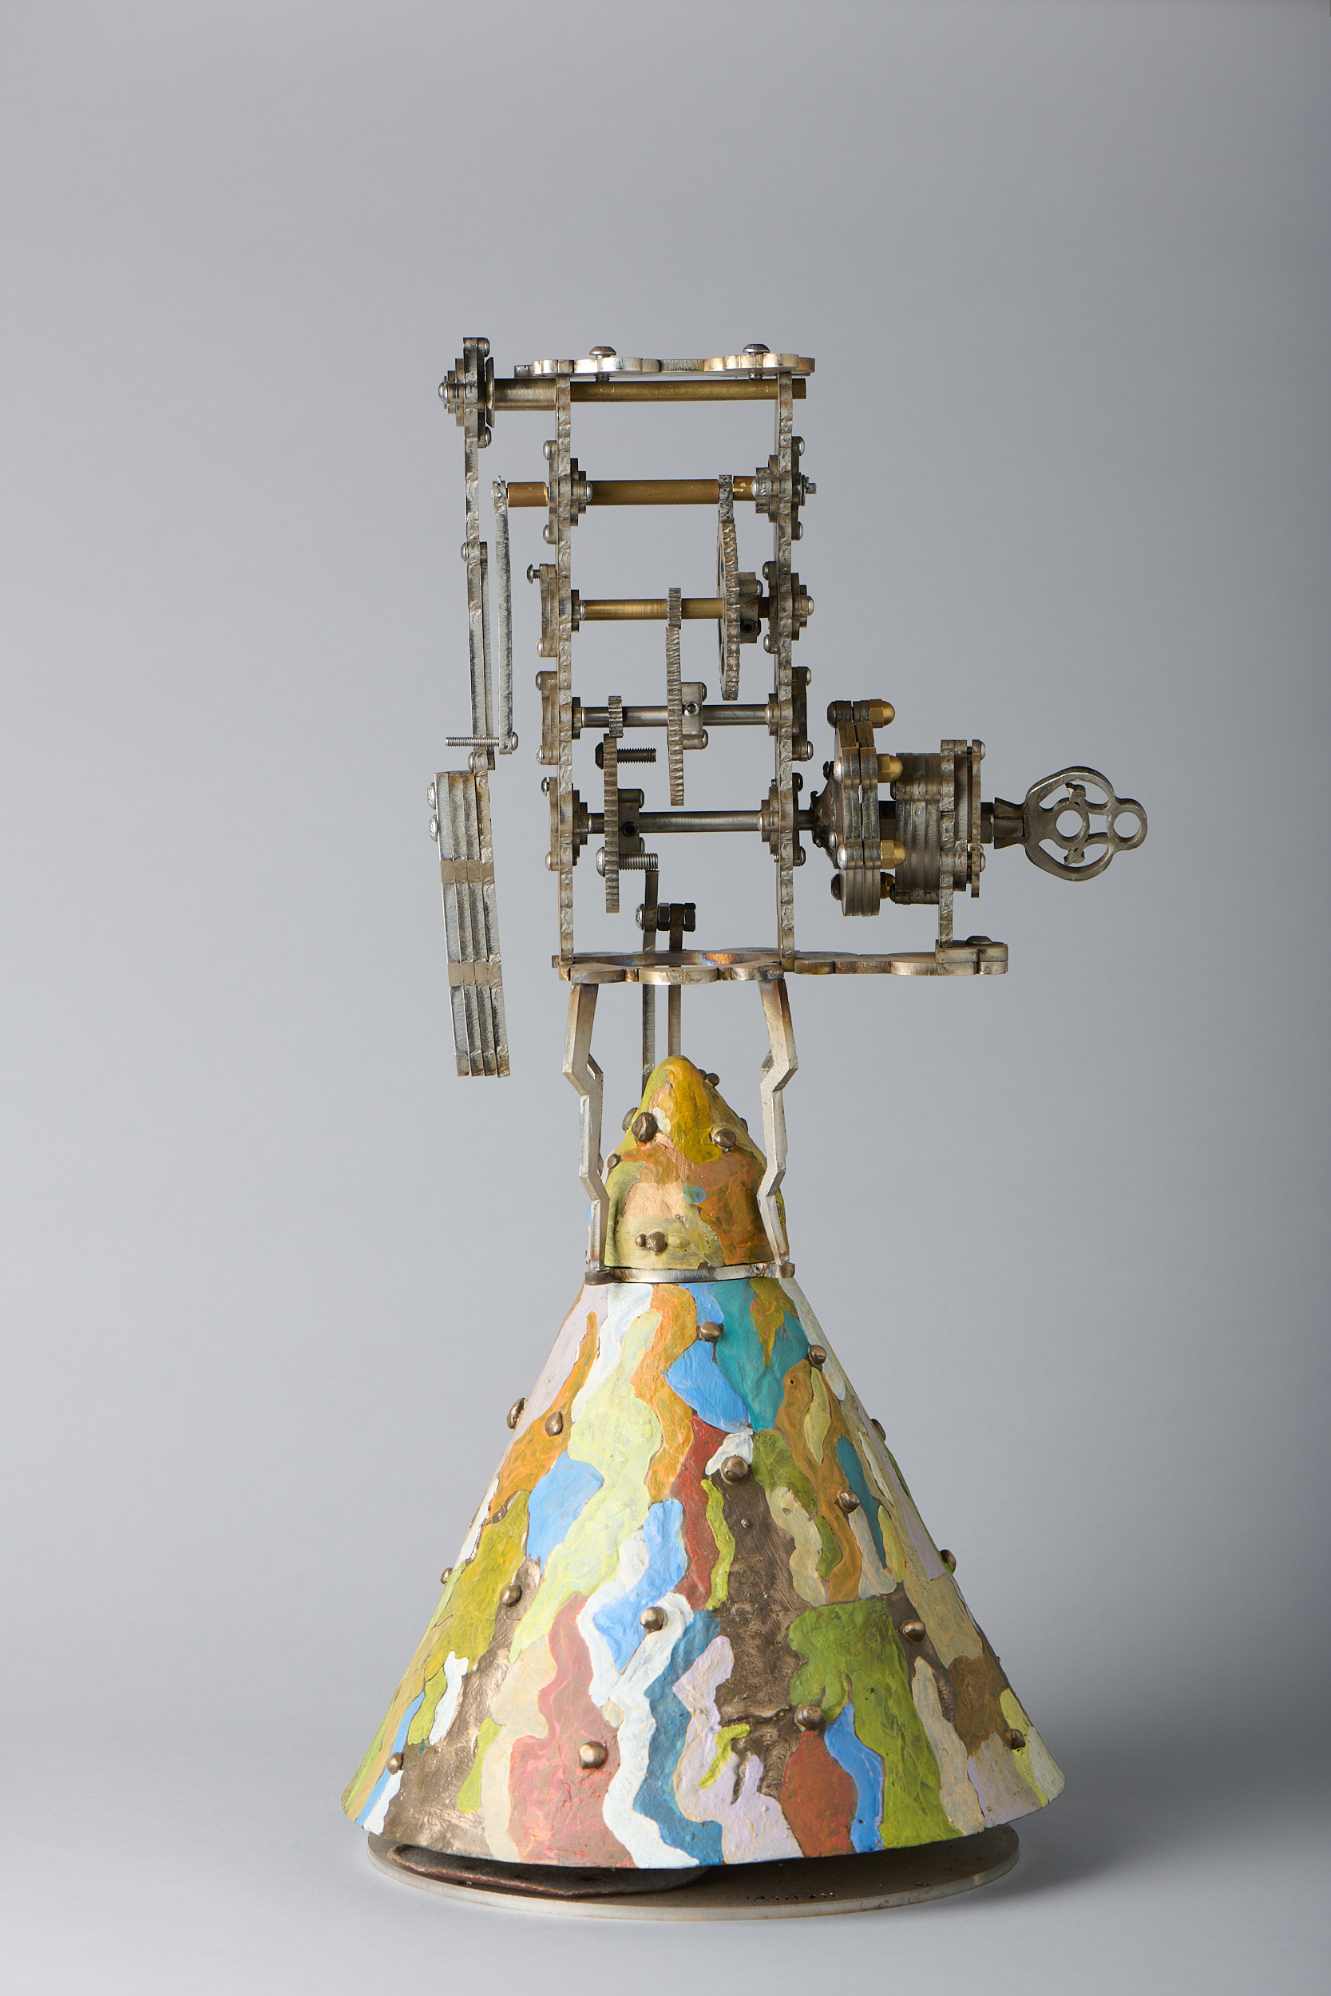
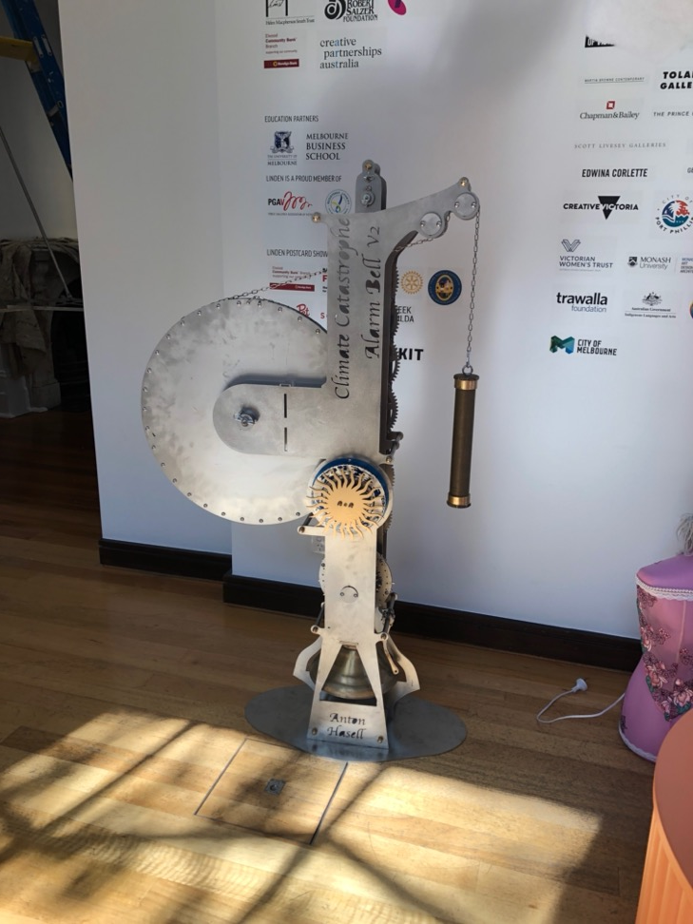
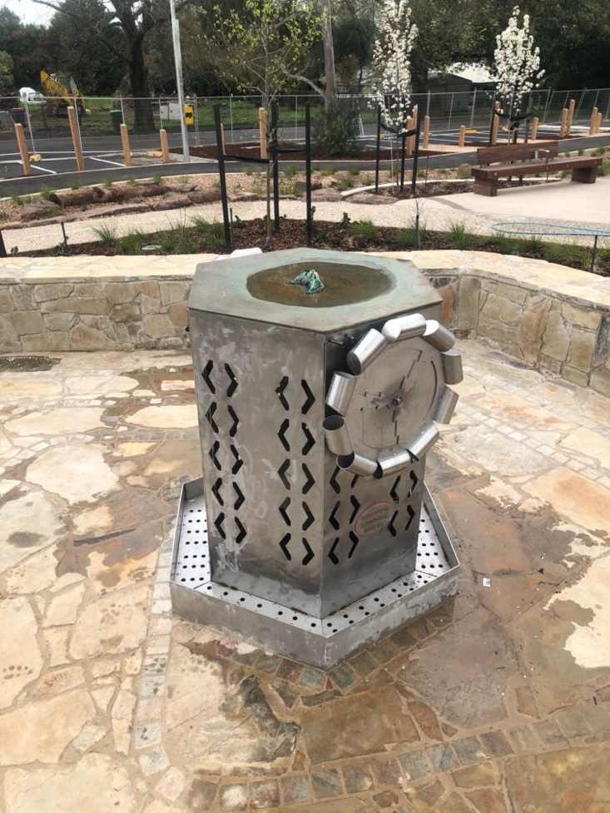
The design, & making clocks with bells

Slide 12
Contact:
Dr Anton Hasell
AUSTRALIAN BELL
www.ausbell.com.au
www.antonhasell.com
E: hasell@westnet.com.au
PH. 61 409235977

